Slide 1
Face Mask Detection
AIMT Department, Lambton College
AML 1214 [Group 2] Python Programming
Prof. Simrandeep Kaur
Group:
Arpit Valand C0857938
Drashti Shukla C0860046
Pratik Patel C0861105
Resha Soni C0859047

Slide 2
Introduction
Feasibility:
It is used to detect whether the person in the image or video is wearing a mask or not.
Requirements
For UI: PySimpleGUI,
Image processing: OpenCV
Core: machine learning model
For the ML model: TensorFlow, Keras, Scikit learning, NumPy and Pandas.
Modules: Visual, Detection, Output.
Visual: It will take input from the user as a person’s face.
Detection: It will detect whether the person is wearing a mask or not.
Output: It will give the result as mask detected or mask not detected.

Slide 3
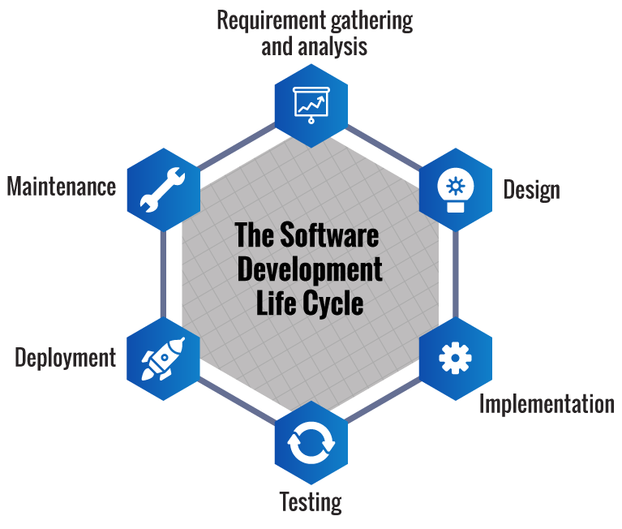
SDLC Approach
Requirement Gathering and Analysis –
The goal is to build an application to detect whether a person is or is not wearing a mask
To gather all the information like how the application will be built, who will be the end-user, what is the purpose of the application. Before building a application a core understanding or knowledge of the application is very important.
Design:
The application is broken into small incremental builds. It is not developed as a complete product in one go. Each build increments in terms of features. The next build is built on previous functionality.
Implementation:
Coding - Coding starts once the design gets done. The Software design is translated into source code. All the components of the application are implemented in this phase.

Slide 4
SDLC Approach
Testing:
Testing starts once the coding is complete and the modules are released for testing. In this phase, the developed application is tested thoroughly and any defects found are assigned to get them fixed.
Deployment:
Once the face mask detector is trained, we can then move on to loading the mask detector, performing face detection and then classifying each face as with_mask or without_mask.
Maintenance:
Analyse the testing and modify the code and program to increase the accuracy and performance.

Slide 5
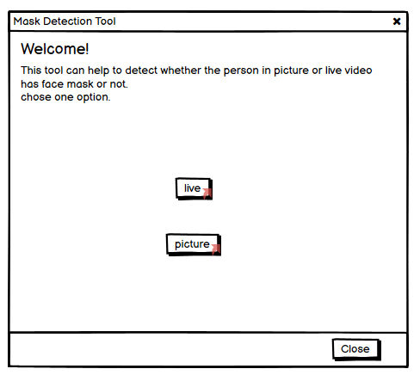
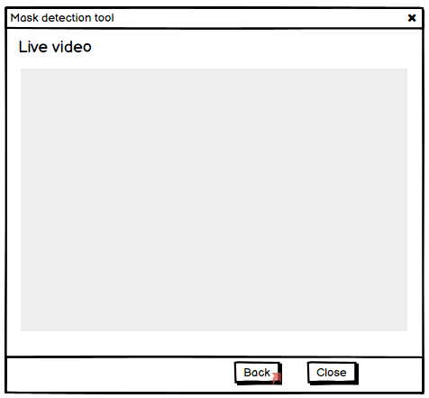
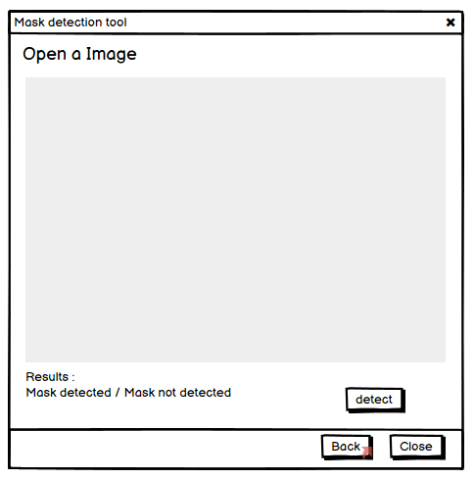
Wire Frame:

Slide 6
Team Members Responsibilities:
Arpit Parekh:
Data collection
Cleansing
Pruning
Drashti Shukla
Testing
Documentation
Report generation
Pratik Patel
Coding
Algorithm preparation
Application development
Resha Soni
Testing
Documentation
Validation

Slide 7
Thank You

